Slide 1
Support Vector Machine
http://sirius.cs.put.poznan.pl/~inf89721/Seminarium/Web_Data_Mining__2nd_Edition__Exploring_Hyperlinks__Contents__and_Usage_Data.pdf

Slide 2
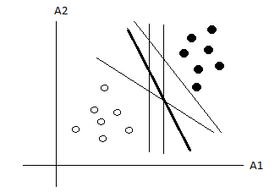
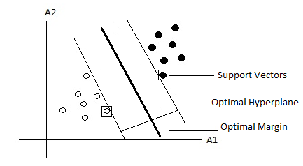
Support Vector Machine (SVM)
Determining the location of decision boundaries (hyperplane) that produce the optimal separation of classes among the infinite number of boundaries.
Optimal hyperplane – constructed by searching for maximal marginal hyperplane.
Margin – sum of distances to the hyperplane from the closest points of two classes.
Sides of margin are parallel

Slide 3
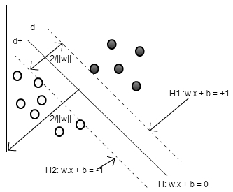
Linear SVM (Separable Case)
Let the Data set D be given as {x_{i}, y_{i}} , where x_{i} =1,2,.....,l (i.e. no. of samples or training tuples) and y_{i} {-1,1} and x_{i} ϵR^{d} .
the separating hyper plane satisfy the equation:

Slide 4

Linear SVM (Cont…)
W is the normal to the hyperplane, and the perpendicular distance from the hyperplane to the origin is
=
Any point that lies on or above the hyperplane satisfies the constraint
combined into one set of inequalities

Slide 5






Linear SVM (Cont…)
The distance of the bounding hyperplane H₁, from origin with normal w is,
Dist (H₁) = =
Similarly, the distance of the bounding hyperplane H₂, from origin with normal w is
Dist (H₂) =
Therefore the margin or distance between two bounding hyperplanes is

Slide 6


Linear SVM (Cont…)
The margin of (w, b) is equal 2/||w||
Goal
Assuming given linearly separable training examples from two classes, the goal is to calculate the separating hyper-plane with maximum margin.
Objective function
Want to maximize 2/||w||, this is equivalent to minimizing which in turn is equivalent to minimizing

Slide 7

Linear SVM (Cont…)
Thus SVM solves the objective function
subject to constraint
This is the convex quadratic programming (QP) problem, which has a single global optimum solution.
Solved in dual space, the space of Lagrange multipliers

Slide 8

Linear SVM (Cont…)
The Lagrangian of this problem is given by
The Lagrange dual function of the optimization problem is given by
Differentiating the primal equation w.r.t. w & b and setting the derivatives equal to 0 gives

Slide 9






Linear SVM (Cont…)
Substituting this value in primal objective function, we get

Slide 10


Linear SVM (Cont…)
The dual problem now can be stated as:
Subject to
and
There is one to one relationship between each Lagrange multiplier and each training example.

Slide 11


Linear SVM (Cont…)
Karush-Kuhn-Tucker condition, which plays a central role in constrained optimization, for the above primal problem can be stated as
This conditions implies that coefficient(Lagrange multipliers) will be nonzero only when xi is a support vector.

Slide 12

Linear SVM (Cont…)
Solution:
bias b, can be computed using a positive SVs as.
compute bias b for optimal separating hyperplane as
The Classifier is then defined as

Slide 13
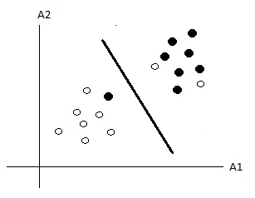
Soft Margin SVM
Non separable data – contains noisy data
Soft margin SVM allows mislabelled data points while still maximizing the margin.
Slack variables – measures the degree of misclassification

Slide 14
Soft Margin SVM (cont…)
The constraints will become
Combining them constraint becomes

Slide 15

Soft Margin SVM (cont…)
The objective function incorporating an extra cost for errors can be written as,
Subject to:
C is a regularization parameter that controls the trade-off between maximizing the margin & minimizing the training error term.

Slide 16

Soft Margin SVM (cont…)
Similar to linear SVM, the lagrangian of the primal form of objective function can be given as:
The solution of above equation is given by the saddle point of the Lagrangian as:

Slide 17



Soft Margin SVM (cont…)
substituting this values into primal form of objective function, the dual problem becomes
Subject to:
and

Slide 18
Soft Margin SVM (cont…)
KKT Conditions

Slide 19
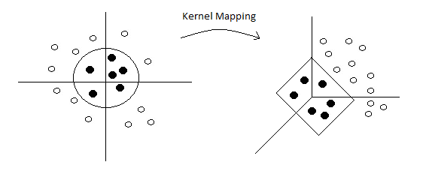
Non-linear SVM
2 steps
The input data (vectors) are transformed into high-dimensional feature space.
Use SVM to find the hyperplane of maximal margin in the new feature space.

Slide 20
Cover's theorem
Cover's theorem
A complex pattern-classification problem cast in a high-dimensional space nonlinearly is more likely to be linearly separable than in a low-dimensional space.
The power of SVMs resides in the fact that they represent a robust and efficient implementation of the principle in Cover's theorem on the separability of patterns.

Slide 21
For example

Slide 22
After Tranformation

Slide 23
By the Transformations

Slide 24
After Transformation

Slide 25

Non-linear SVM
Let Ф be a nonlinear mapping function,
Where
With this transformation of data, the hyperplane representing decision boundary can be defined as
Using the Ф(.) function, the weight becomes

Slide 26


Non-linear SVM
The decision function becomes
And the dual problem can be rewritten as

Slide 27
Non-linear SVM(Cont…)
feature mapping function always appear as dot products
computing it in high or even infinite dimensional space
Complex
Costly
Suffer from curse of dimensionality

Slide 28

Non-linear SVM(Cont…)
E.g. let’s consider the cost function
Where
Assume that
The above objective function requires
n²/2 dot products to compute all .
Each dot product requires d²/2 additions and multiplications.
The whole thing requires n²d² /2 operations....

Slide 29
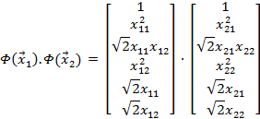
Non-linear SVM(Cont…)
Consider the two points
Let
Here,

Slide 30
Non-linear SVM(Cont…)
Instead of this if we consider,
In this case, if
n²/2 dot products to compute all .
Each dot product requires only (d+1) additions and multiplications.
The whole thing requires dn²/2 operations....

Slide 31
Kernel Functions
SVM learning requires only on the dot product Φ(x_{i}). Φ(x_{j})
between training examples as opposed to the individual Φ(x_{i})
application of an SVM to a novel feature vector x depends only on the dot product Φ(x_{i}). Φ(x) between x and the support vectors
Therefore, operations in high dimensional space do not have to be performed explicitly if we find a function such that
Here, Is called a kernel function in SVM terminology.

Slide 32


Kernel Functions (cont…)
Kernel function allows to calculate the dot product of (Φ(x_{i}), Φ(x_{j})) without explicitly applying function to input vector.
The dual problem is now defined using the kernel function as:
Subject to
and
The classification function becomes

Slide 33
Validity of Kernel Functions
A kernel function K is valid if there is some feature mapping Φ, such that
Mercer’s theorem proves that a kernel function is valid, if and only if the following condition is satisfied, for any function g(x)

Slide 34

Validity of Kernel
If K is a valid kernel, then the corresponding kernel matrix is
Symmetric
Positive (Semi-) definite, i.e. for any vector

Slide 35

Some well known Kernels
Linear Kernel
Polynomial Kernel
Radial Basis Function (RBF) Kernel
Sigmoid Kernel
Convex combinations of Kernels
Normalization Kernel

Slide 36
Advantages of SVM
The complexity of learned classifier is characterized by the number of support vectors rather than the dimension of data. Hence, SVM is less prone to overfitting compared to other classification methods.
The number of SVs found can be used to compute an upper bound on the expected rate of the SVM classifier, which is independent of data dimensionality.
It has good generalization capability by maximizing the margin in input space.

Slide 37
Thank you

